Slide 1
Graph Data Structure

Slide 2
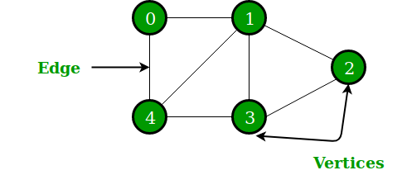
A Graph consists of a finite set of vertices(or nodes) and set of Edges which connect a pair of nodes.

Slide 3
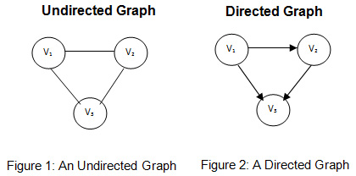
Directed and Undirected Graph
Undirected graphs have edges that do not have a direction. The edges indicate a two-way relationship, in that each edge can be traversed in both directions. Directed graphs have edges with direction. The edges indicate a one-way relationship, in that each edge can only be traversed in a single direction.

Slide 4
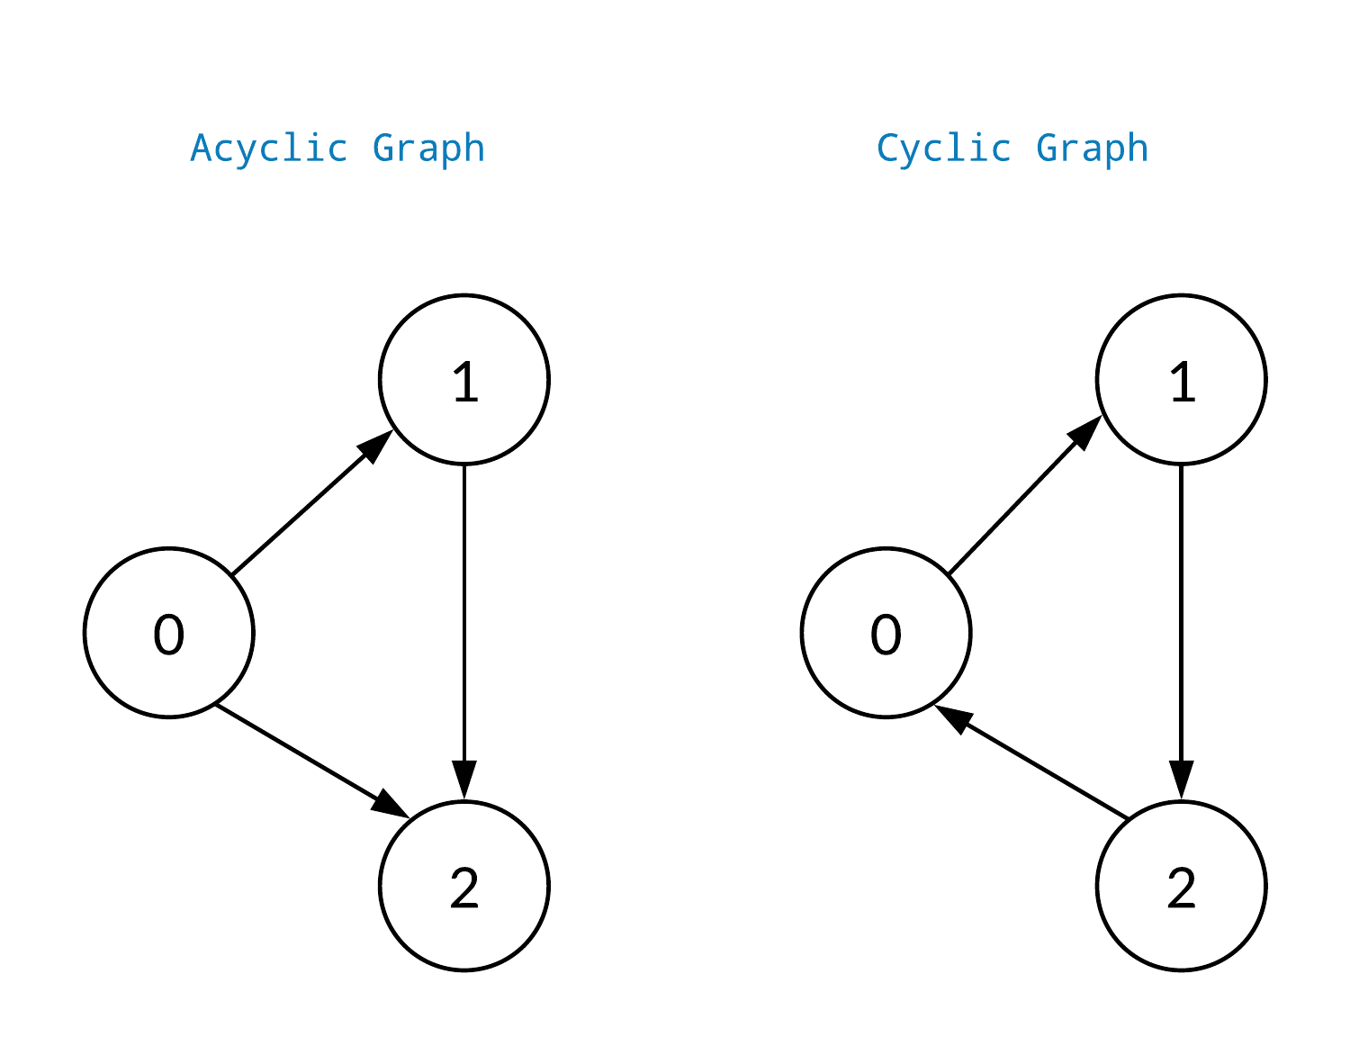
Cyclic and Acyclic Graph

Slide 5
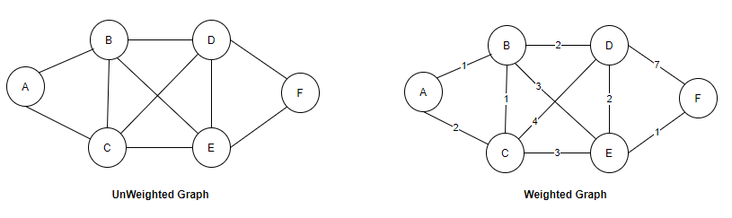
Weighted and Un-weighted Graph
If edges in your graph have weights then your graph is said to be a weighted graph, if the edges do not have weights, the graph is said to be un-weighted.

Slide 6
Applications of Graph Data Structure:
Google Maps – to find shortest path between 2 places.
In Facebook, users are considered to be the vertices and if they are friends then there is an edge running between them. Facebook’s Friend suggestion algorithm uses graph theory. Facebook is an example of undirected graph.
In World Wide Web, web pages are considered to be the vertices. There is an edge from a page u to other page v if there is a link of page v on page u. This is an example of Directed graph.

Slide 7
Graph Representation
The following two are the most commonly used representations of a graph.
1. Adjacency Matrix
2. Adjacency List

Slide 8
Adjacency Matrix
Adjacency Matrix is a 2D array of size V x V where V is the number of vertices in a graph. Let the 2D array be adj[][], a slot adj[i][j] = 1 indicates that there is an edge from vertex i to vertex j. Adjacency matrix for undirected graph is always symmetric.

Slide 9
Properties of Adjacency Matrix
Space Required – O(V*V)
Operations :
Check if u & v are connected – O(1)
To find all adjacent of a vertex – O(V)
Add/Remove an edge – O(1)
Add/Remove a vertex – O(V*V) (reallocate space)

Slide 10
Adjacency List
An array of lists is used. The size of the array is equal to the number of vertices. Let the array be an array[]. An entry array[i] represents the list of vertices adjacent to the ith vertex. This representation can also be used to represent a weighted graph. The weights of edges can be represented as lists of pairs.

Slide 11
Properties of Adjacency List
Space Complexity : O(V+E)(directed graph) O(V+2E) (undirected graph)
Check if there’s an edge from u to v : O(V)
Add an edge : O(1)
Remove an edge: O(V)

Slide 12
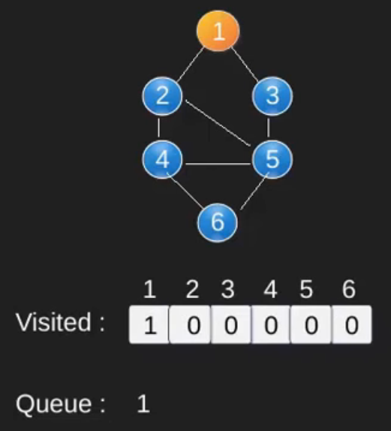
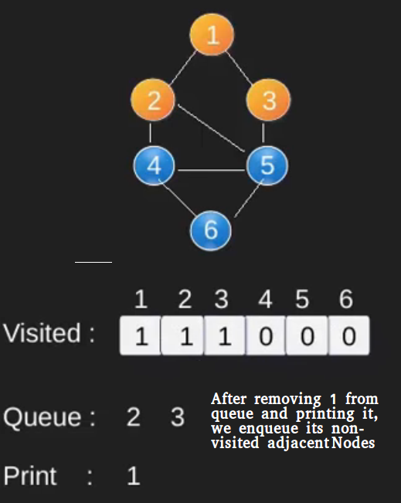
Breadth First Search

Slide 13
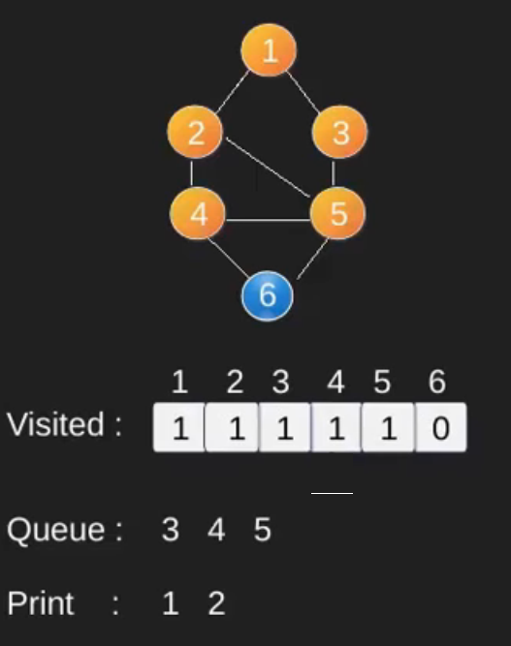
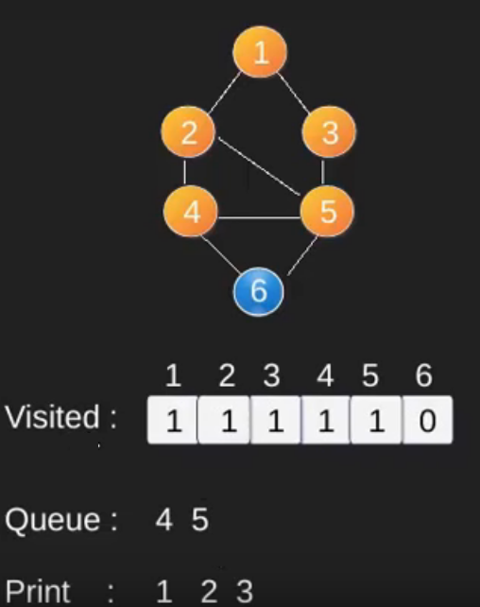
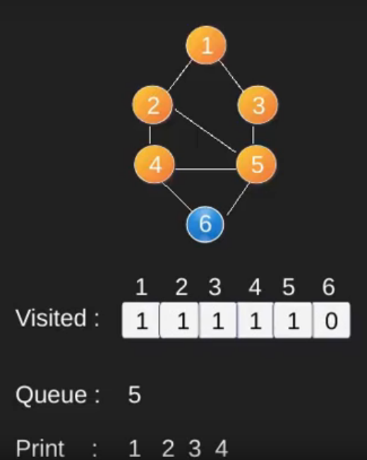

Slide 14
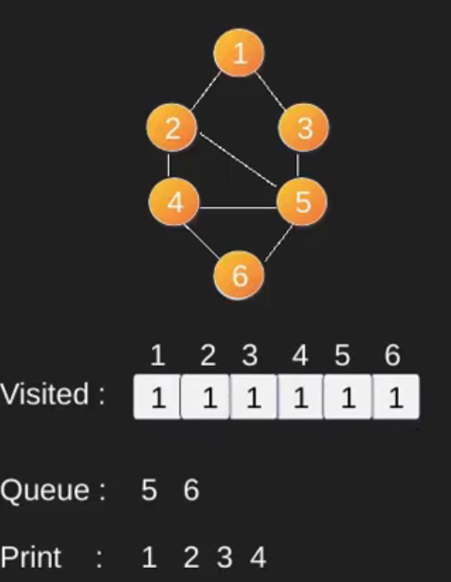
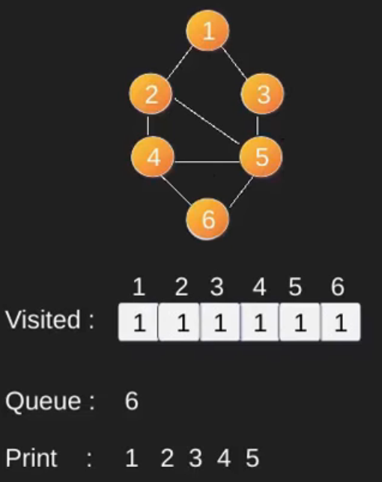
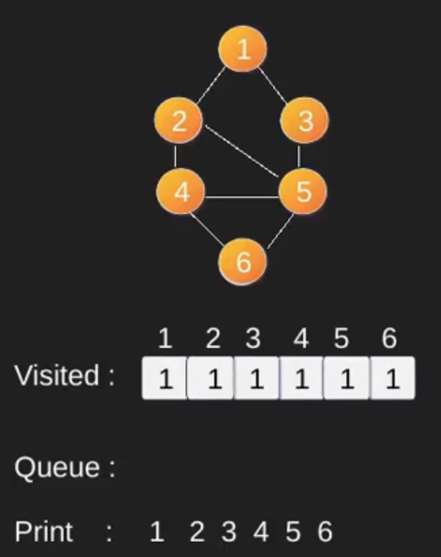

Slide 15
Applications of BFS
Shortest path in un-weighted graph.
Crawlers in search engine.
Social networking search
Broadcasting

Slide 16
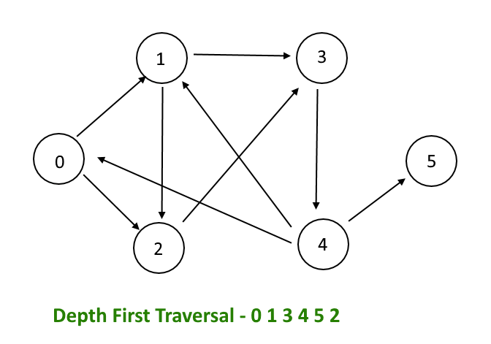
Depth First Search

Slide 17
Dijkstra’s Shortest Path Algorithm

Slide 18
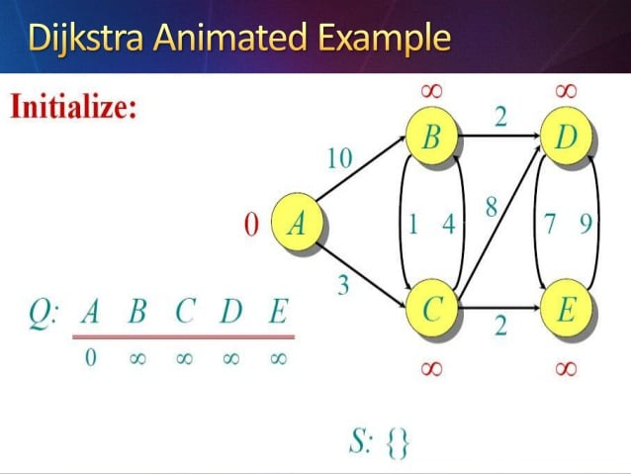

Slide 19
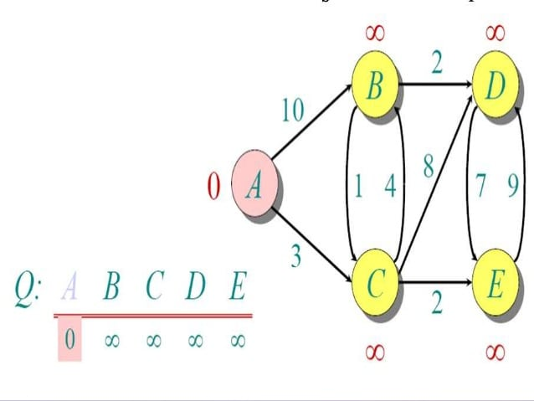

Slide 20
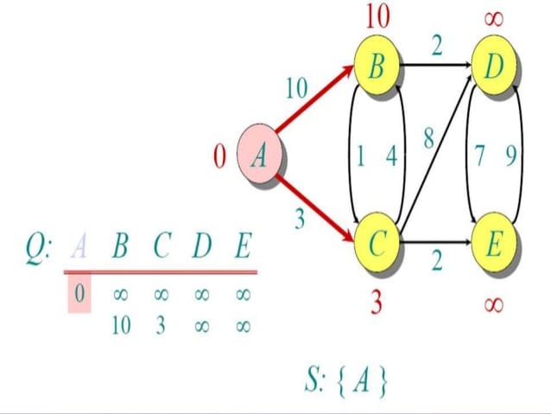

Slide 21
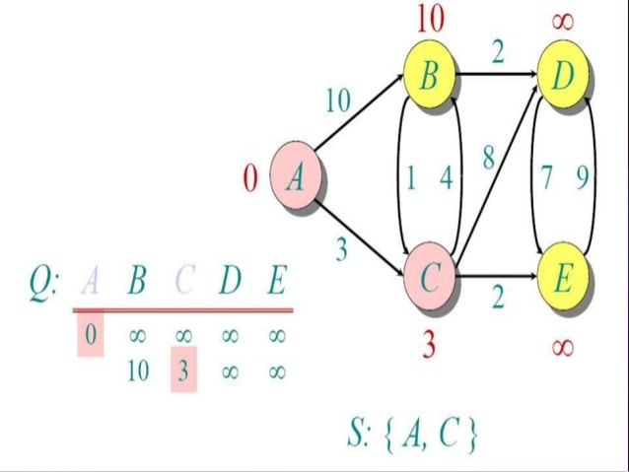

Slide 22
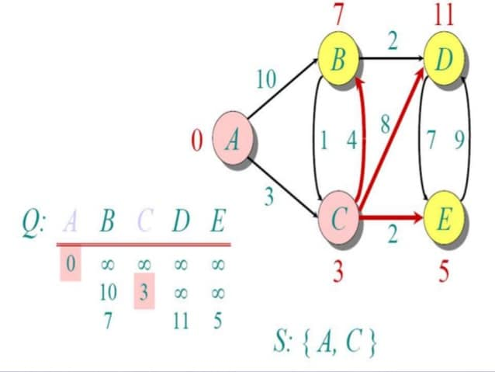

Slide 23
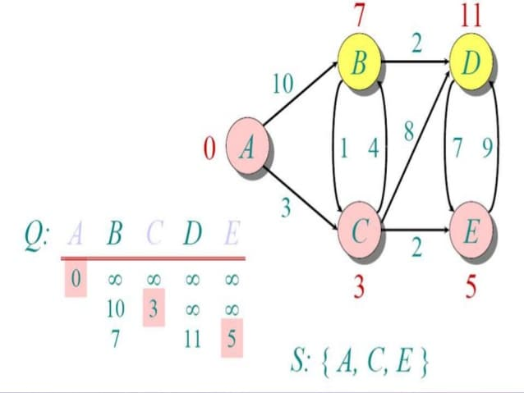

Slide 24
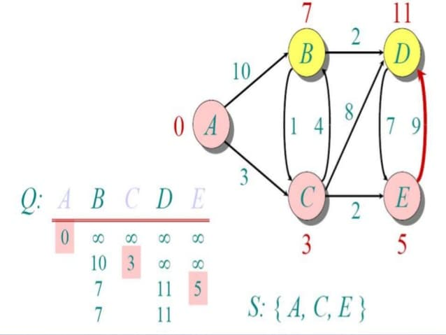

Slide 25
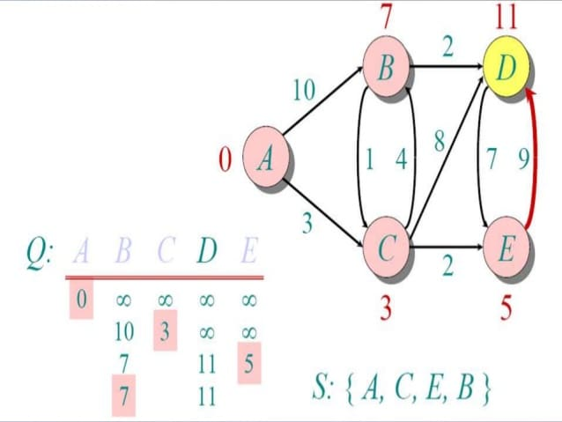

Slide 26
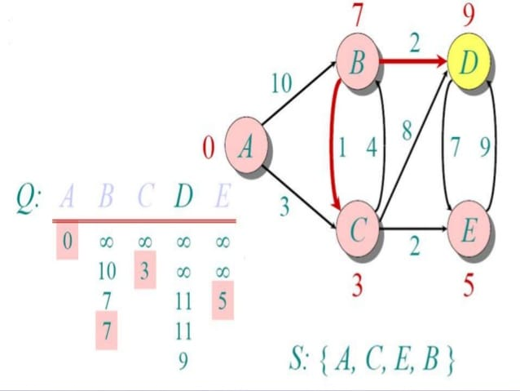

Slide 27
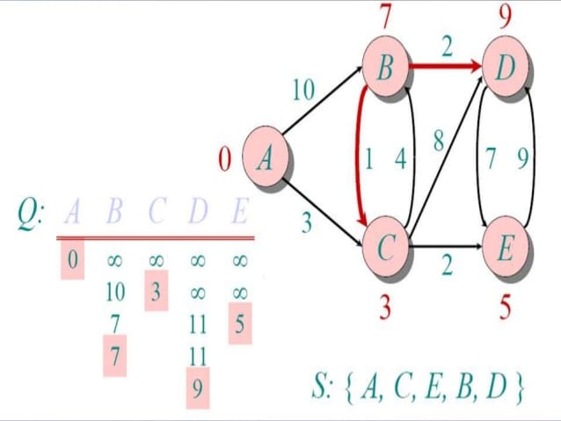

Slide 28
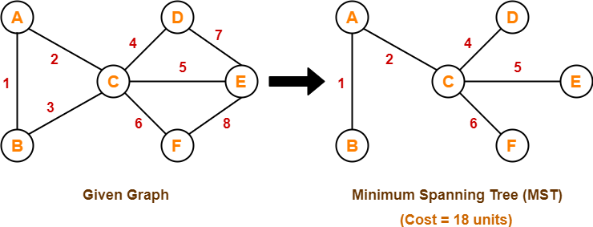
Minimum Spanning Tree
A minimum spanning tree (MST) or minimum weight spanning tree is a subset of the edges of a connected, edge-weighted undirected graph that connects all the vertices together, without any cycles and with the minimum possible total edge weight.

Slide 29
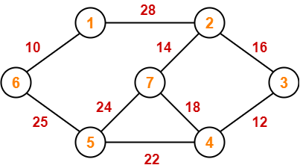
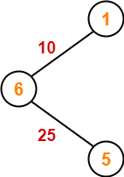
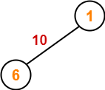
Prim’s Algorithm

Slide 30
